Slide 1
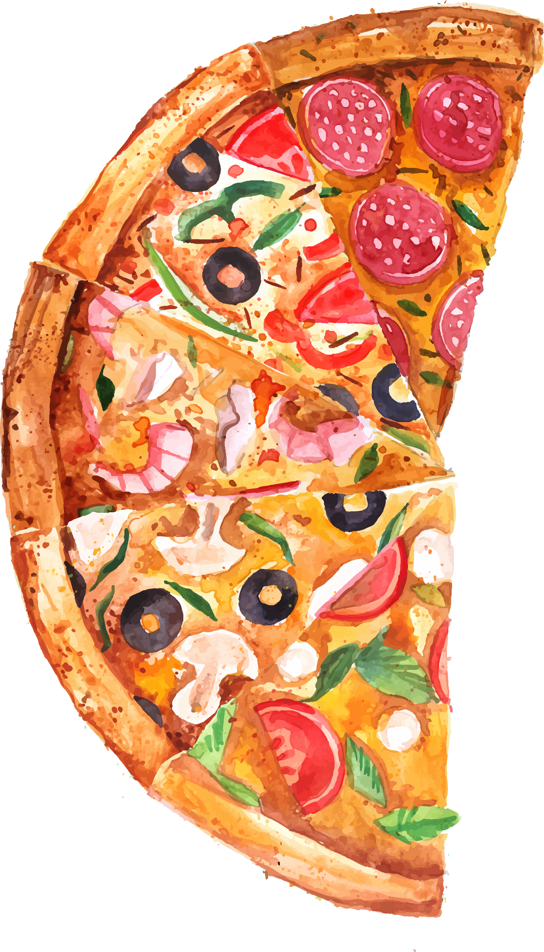
PIZZA HUT ANALYSIS
Presented by HARI PRIYA

Slide 2
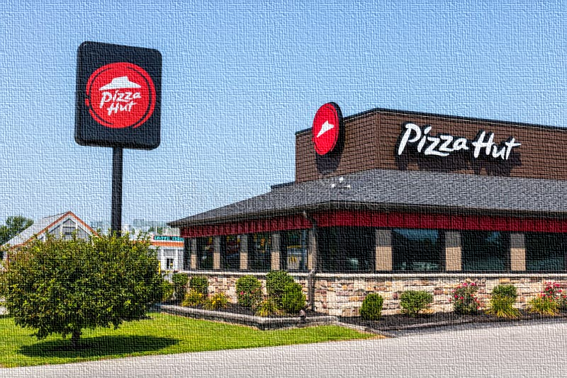
ABOUT PIZZAHUT
Pizza Hut, founded in 1958 in Kansas, USA by Dan and Frank Carney, is one of the world’s leading pizza restaurant chains. Owned by Yum! Brands, Inc., the company operates in more than 100 countries with thousands of outlets.
It offers a wide variety of pizzas, pasta, sides, and desserts, and is widely recognized for its innovation, including the introduction of stuffed crust pizzas.
With a strong presence in dine-in, takeaway, and online delivery services, Pizza Hut continues to focus on enhancing customer experience and embracing digital ordering to meet modern consumer needs.

Slide 3

TABLE OF CONTENT
INTRODUCTION | Overview of Pizza Hut and the purpose of the analysis
PROBLEM STATEMENT | Key challenges or business issues to be addressed
DATASET OVERVIEW | Source of data Key variables and attributes Data cleaning & preprocessing steps
ANALYSIS | SQL ,TABLEAU,WORD,POWERPOINT. Descriptive statistics Basic Analysis Intermediate Analysis Advance Analysis
INSIGHTS | Key findings from the analysis Patterns and correlations identified
RECOMMENDATIONS | Actionable strategies to improve sales and customer satisfaction Data-driven suggestions for business growth
Tools Used

Slide 4
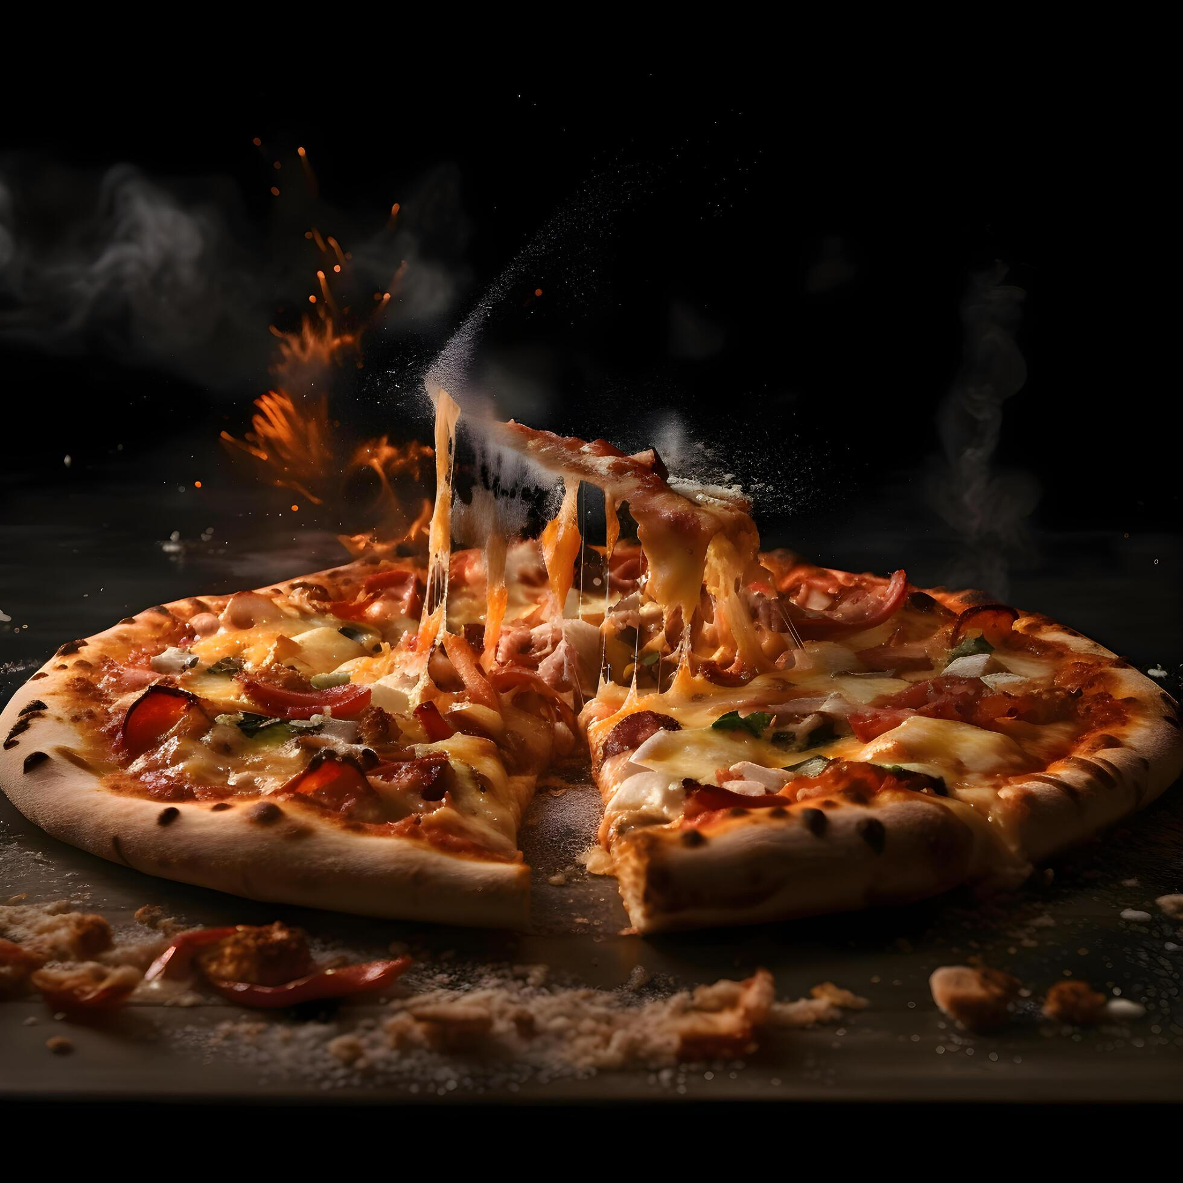

INTRODUCTION
Pizza Hut, being one of the world’s largest pizza chains, generates a vast amount of transactional data through its daily operations. Analyzing this data is essential to understand customer preferences, sales performance, and revenue distribution. This case study focuses on exploring Pizza Hut’s sales dataset using SQL queries to uncover meaningful patterns and actionable insights.
The primary goal of this analysis is to examine customer ordering behavior, identify the most popular pizzas, determine peak ordering times, and evaluate revenue contributions across different pizza categories.

Slide 5
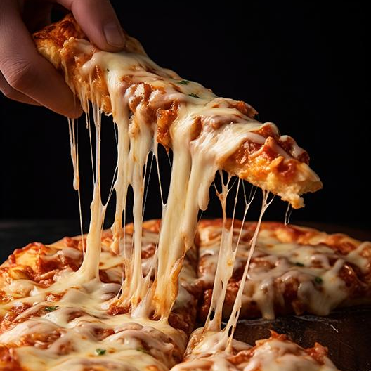
PROBLEM STATEMENT
Pizza Hut, being a leading player in the fast-food industry, handles large volumes of customer transactions daily. However, identifying the key factors that drive sales, customer preferences, and overall business performance remains a challenge. The company needs a data-driven analysis to:
Identify top-performing Analyze sales trends across time,
-underperforming products location and categories
Detect factors of customer Provide actionable to improve satisfaction and purchases revenue and customer behaviour
Notes:
det

Slide 6
DATASET OVERVIEW
File Name | Description | Key Columns
Pizzas.csv | Details unique pizzas : ID, type , sizes and prices. | Pizza _id , pizza _ type _id ,size ,price
Pizza_types.csv | Describes each pizza type:ID,name,category and ingredients. | Pizza _ type_ id ,name ,category , ingredients
Orders.csv | Records each customer order:ID,date and time. | Order _id , date, time
Order_details.csv | Links orders of pizzas:details ID,order ID,pizza ID and quantity. | Order_details_id,order_id,pizza_id, quantity

Slide 7
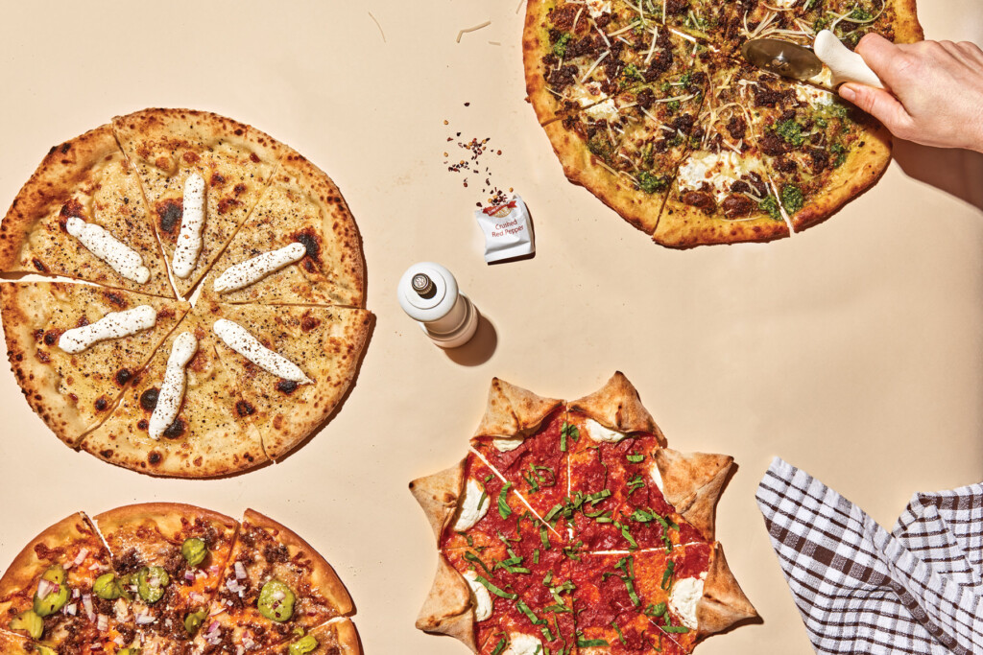





TOOLS USED
SQL (MySQL /SQLite) :
For querying and analyzing raw sales data.
Tableau / Power BI :
For interactive dashboards and advanced data visualizations.
PowerPoint :
For presenting findings and insights in a storytelling format
Word / PDF :
For documenting SQL queries, outputs, insights, and recommendations

Slide 8

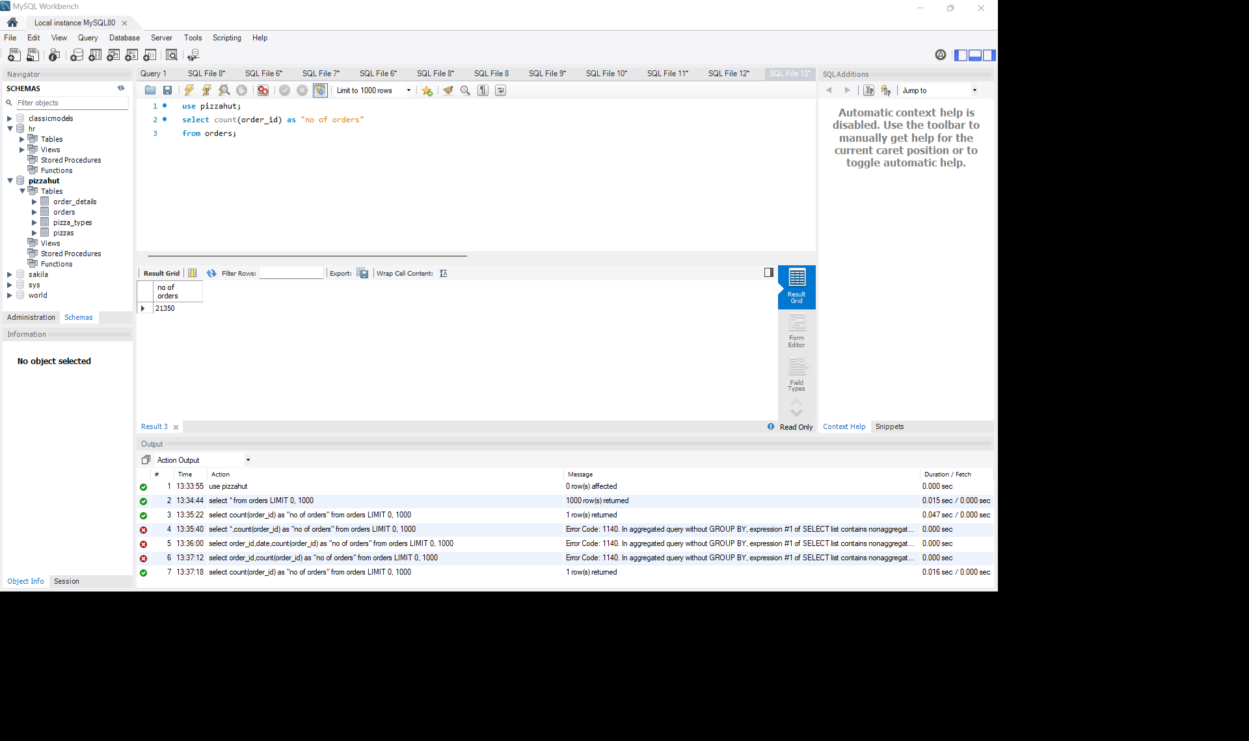
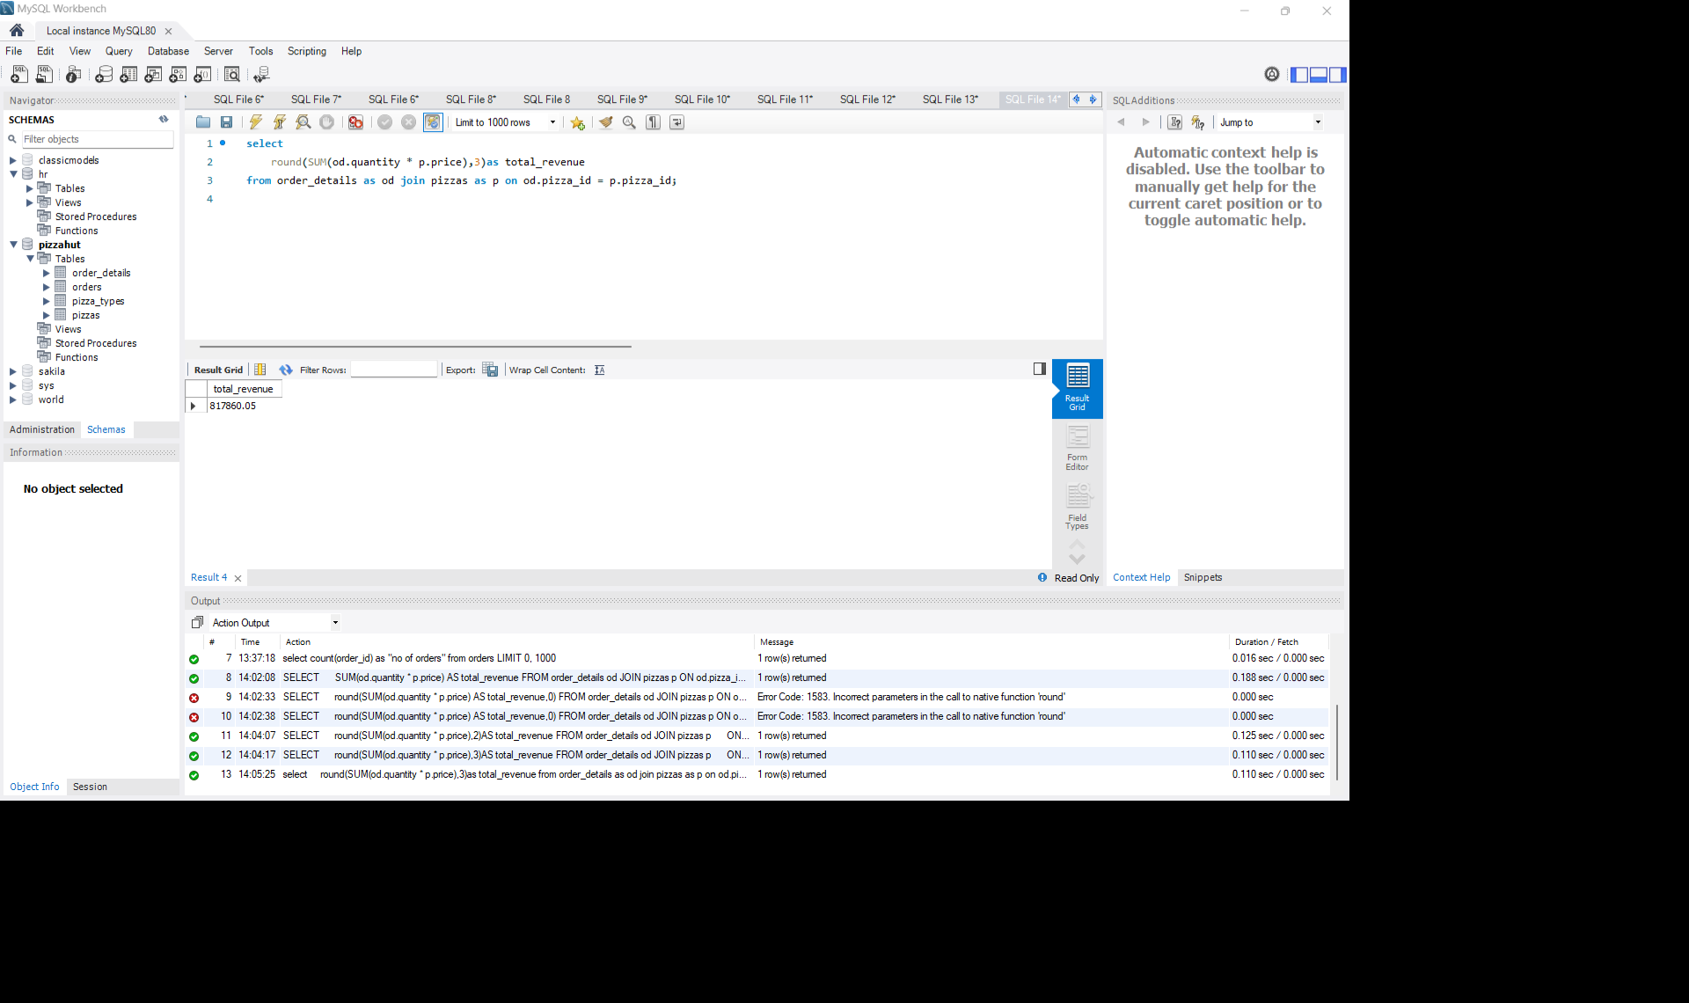
Basic Analysis
Total Order Count:
Revenue Calculation:
The Total no of orders: 21350
Total Revenue: 817860.05

Slide 9
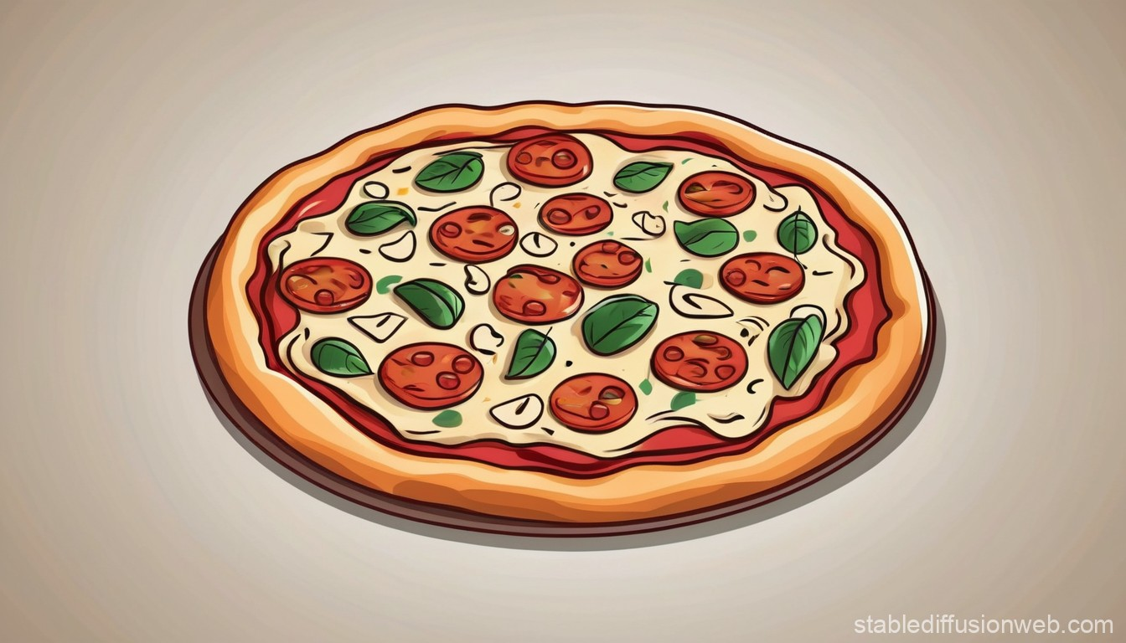
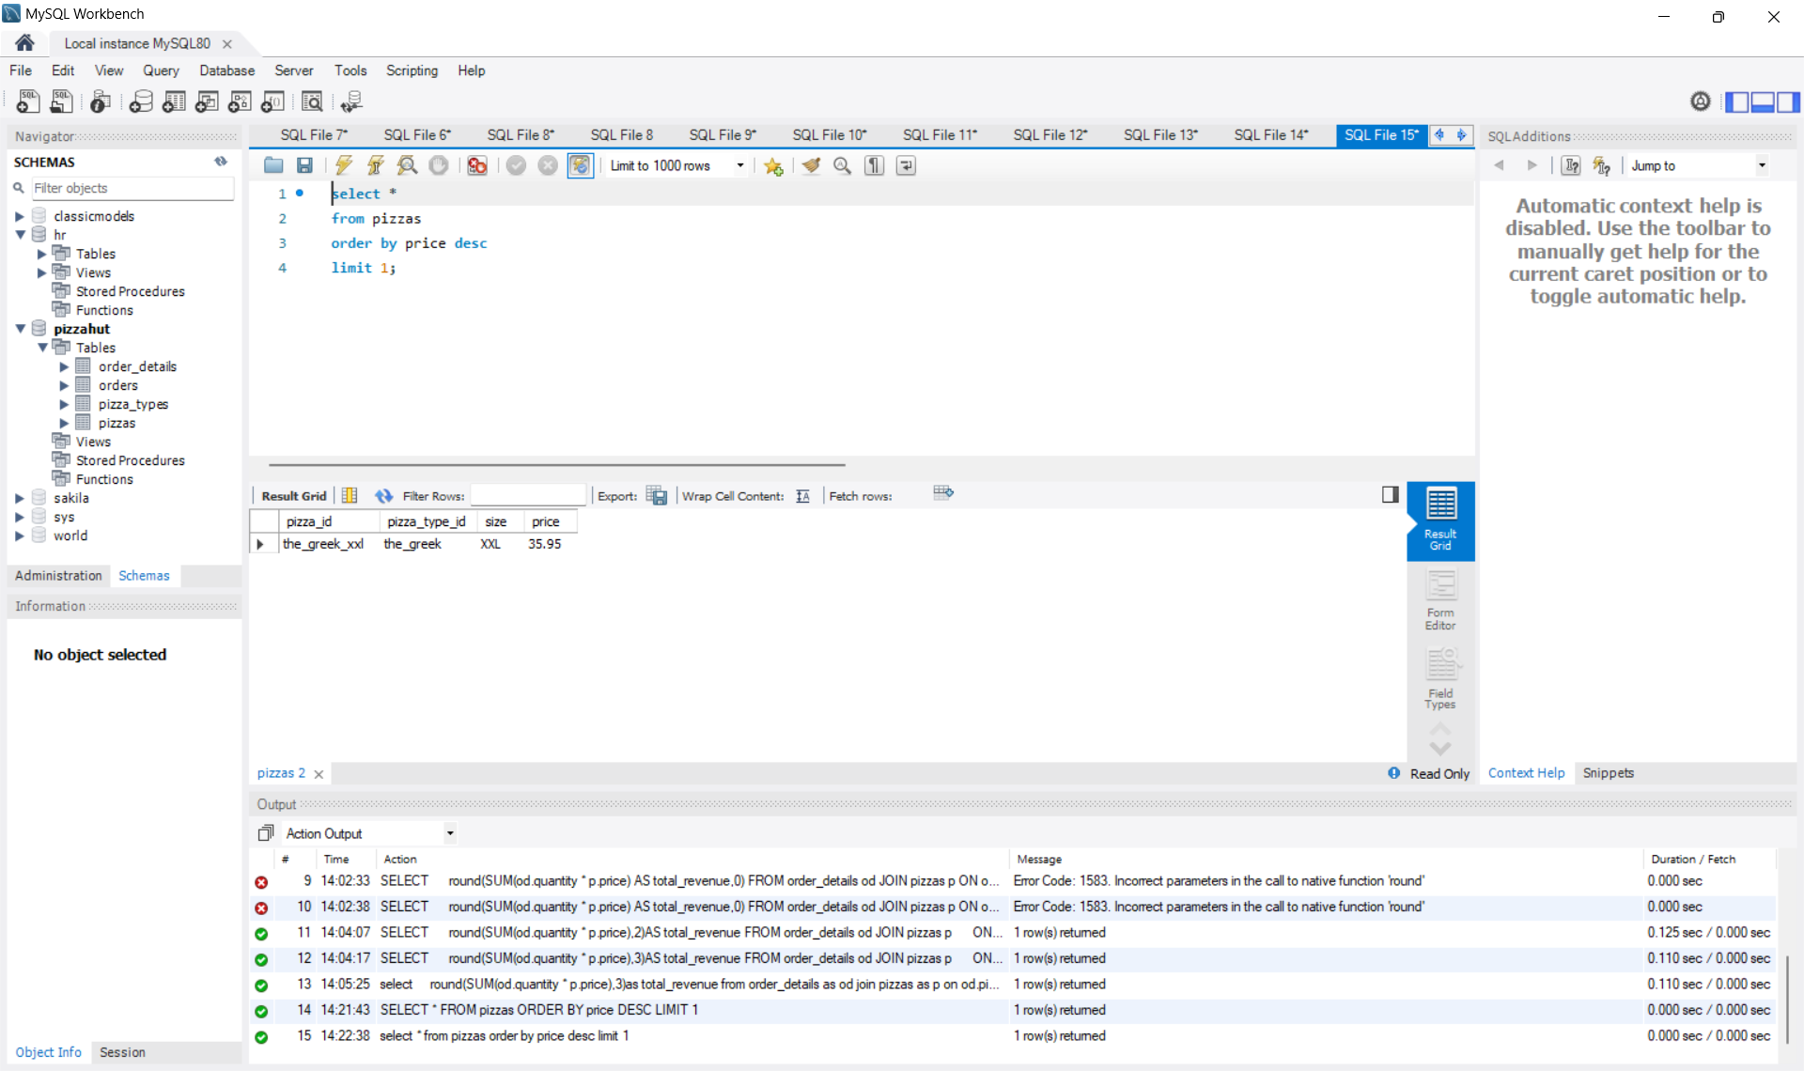
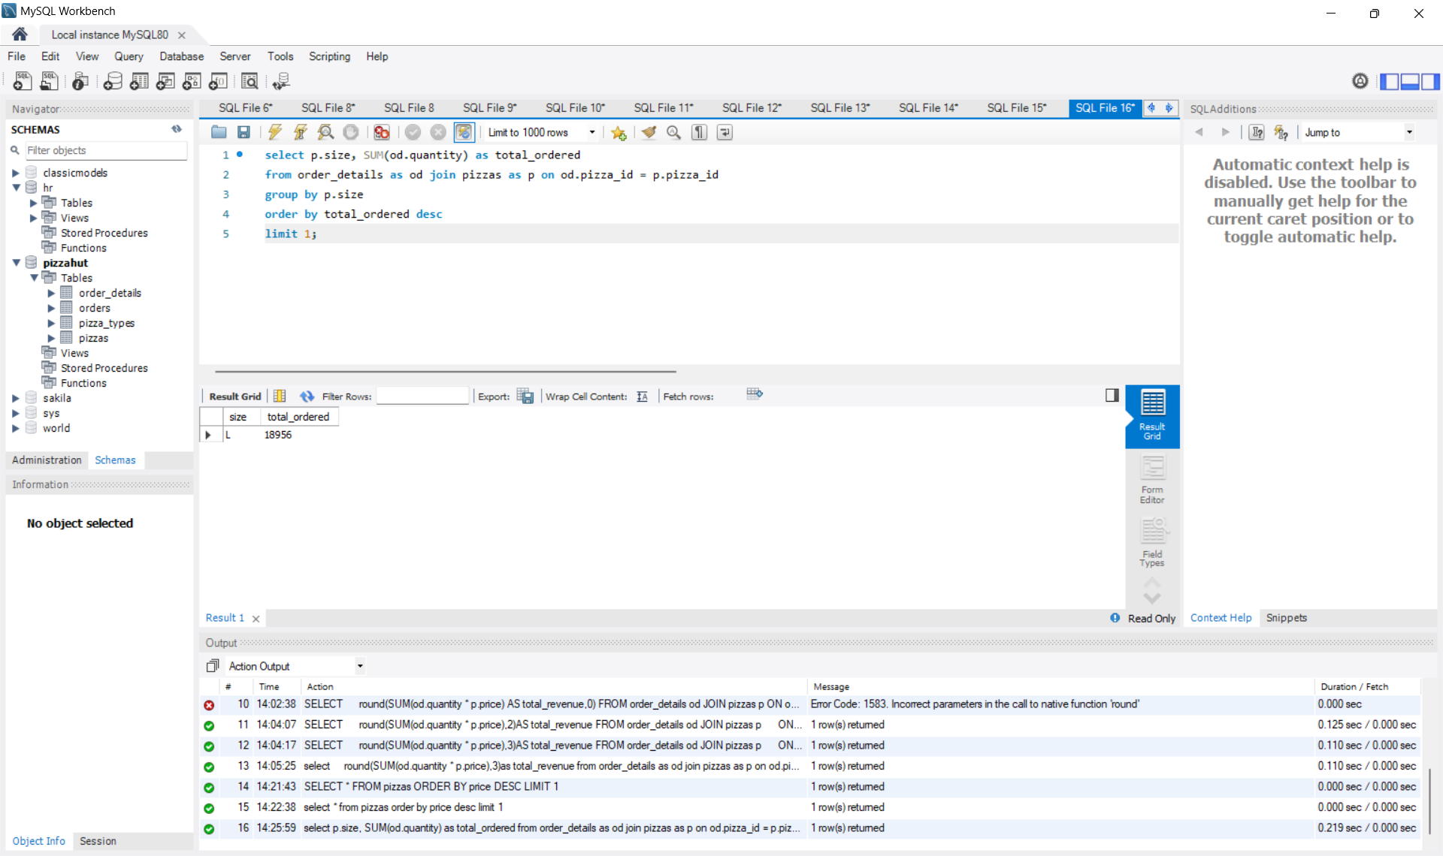
Most Expensive Pizza:
Most Ordered Pizza Size:
Most expensive pizza is : the _greek
Most ordered pizza size is : L

Slide 10

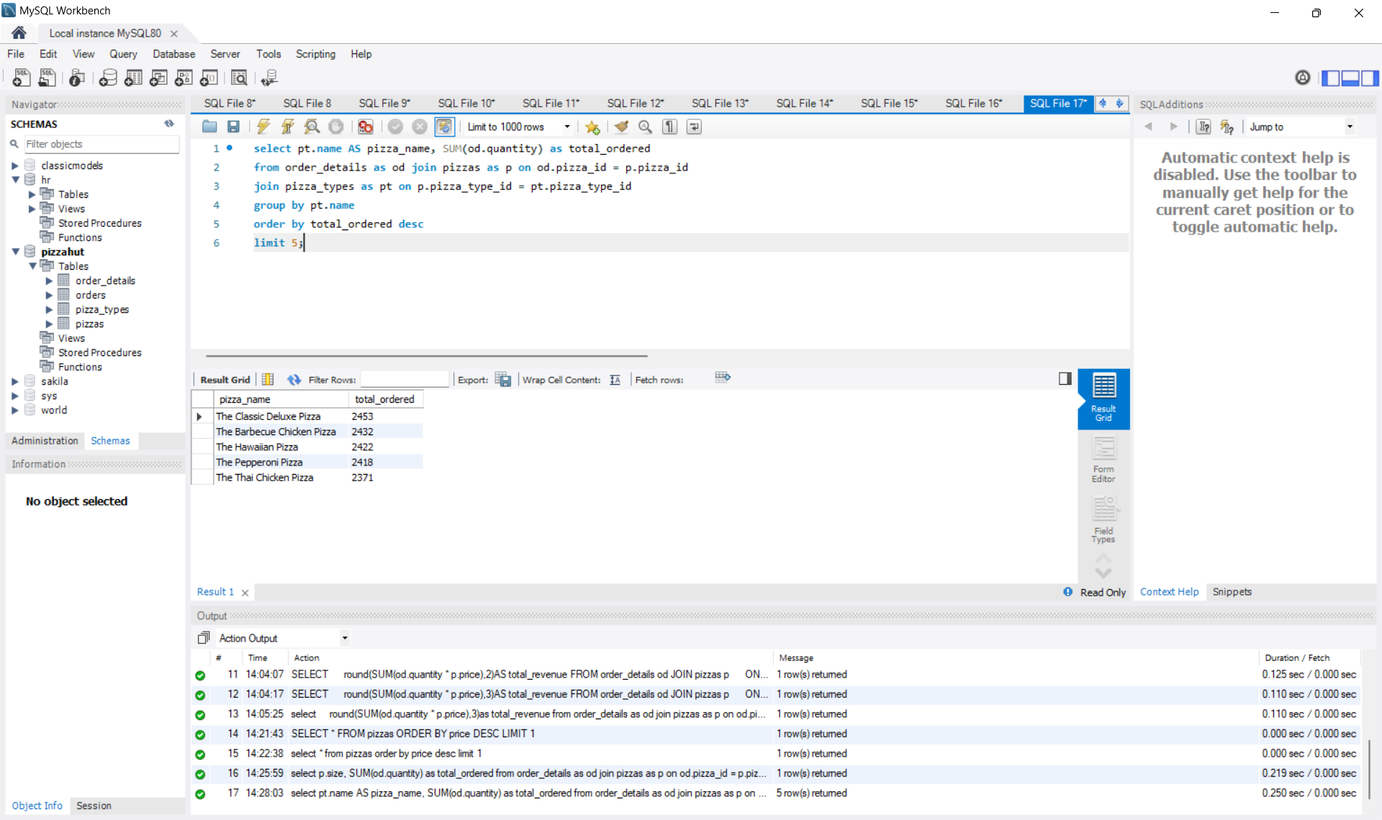
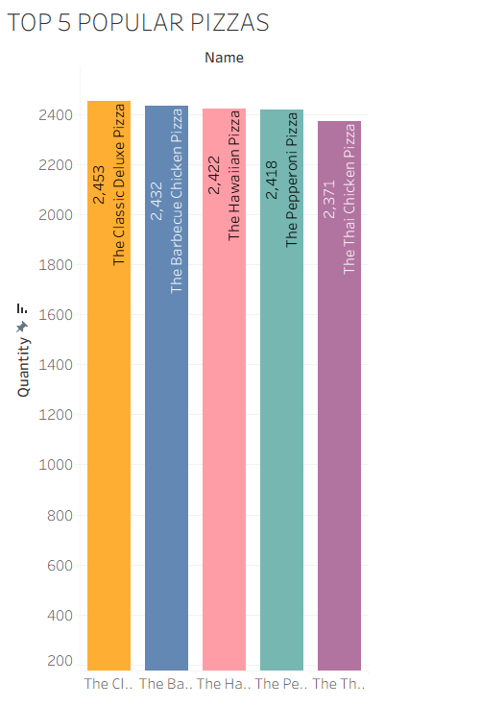
Top 5 popular pizzas :
Bar Graph :

Slide 11

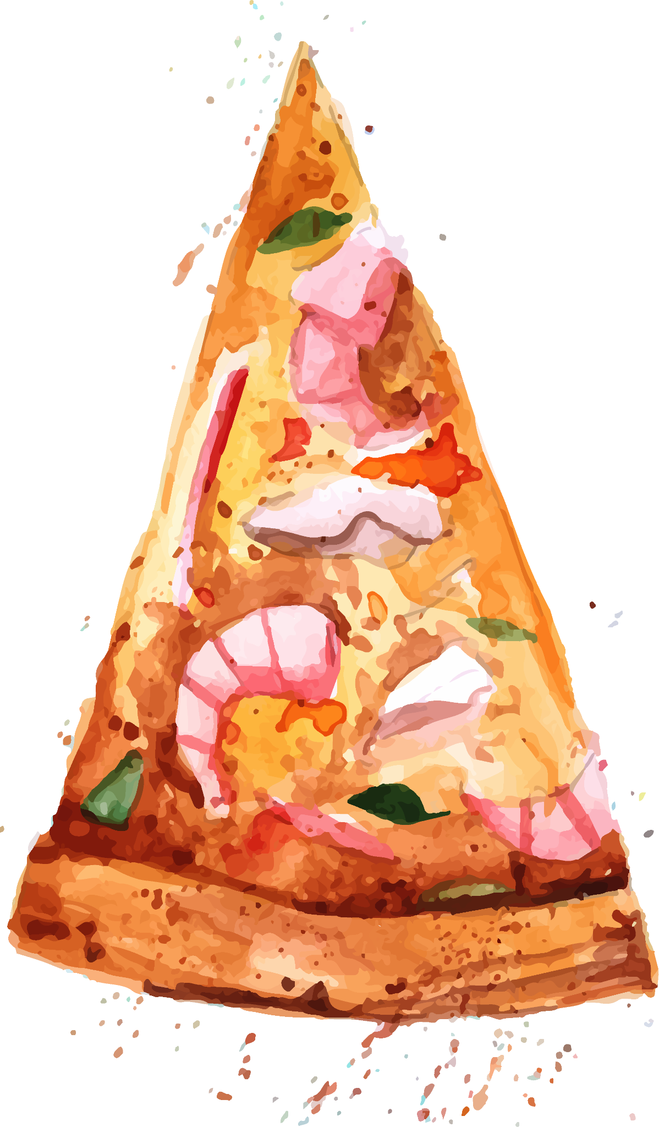
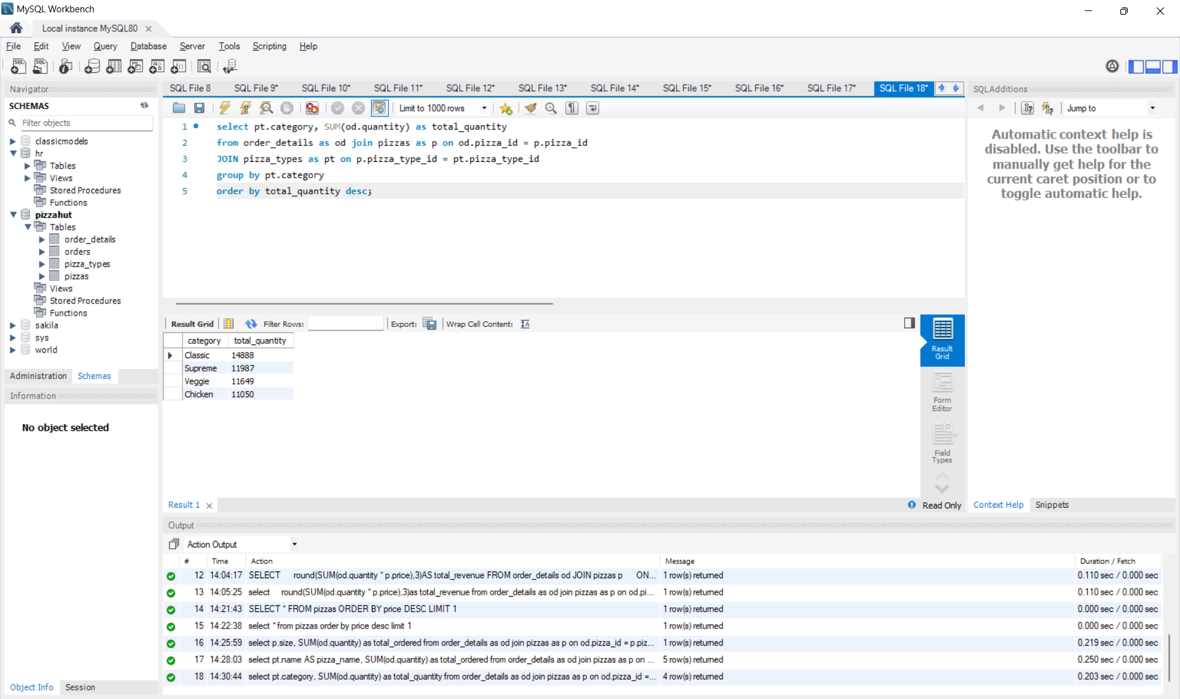
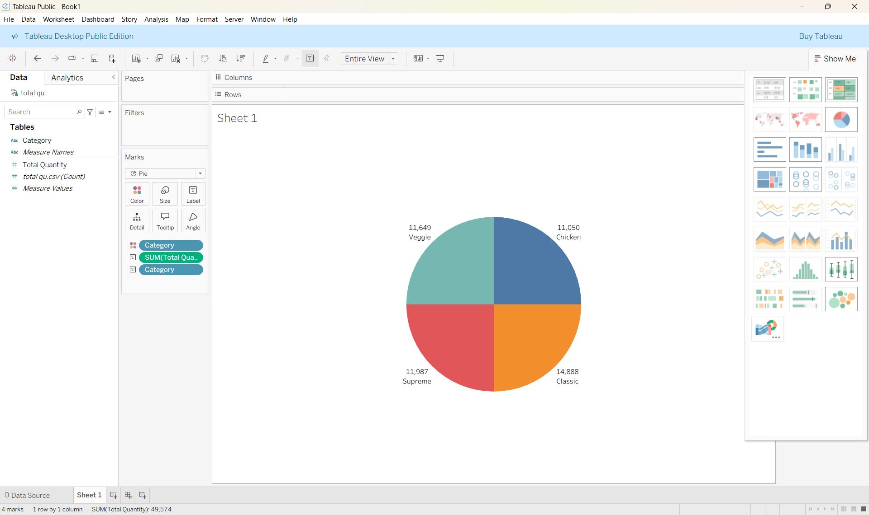
Intermediate Analysis
Pizza Quantity by Category :
Pie Chart :

Slide 12

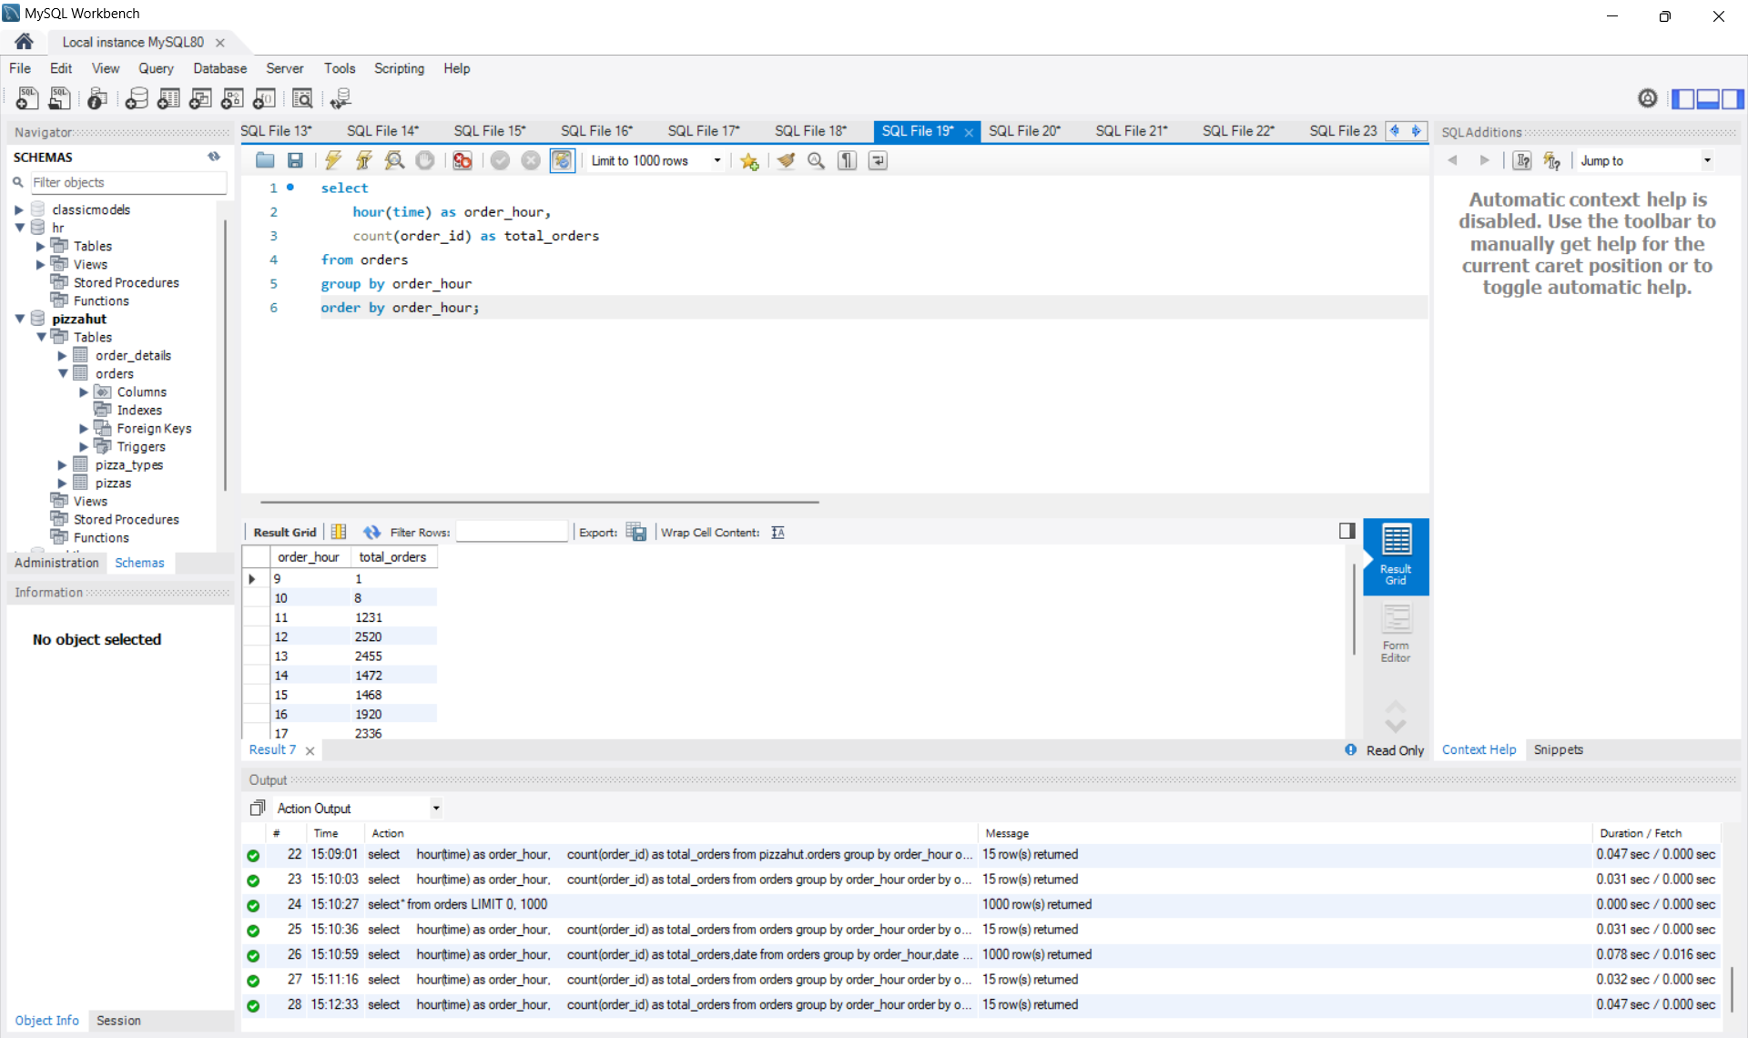
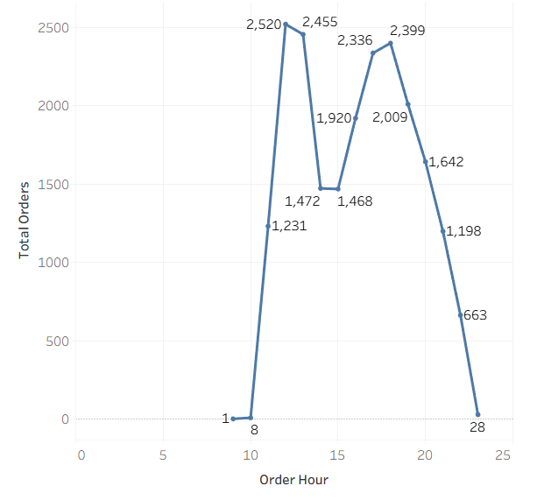
Order Trends By Hour :
Line chart :

Slide 13
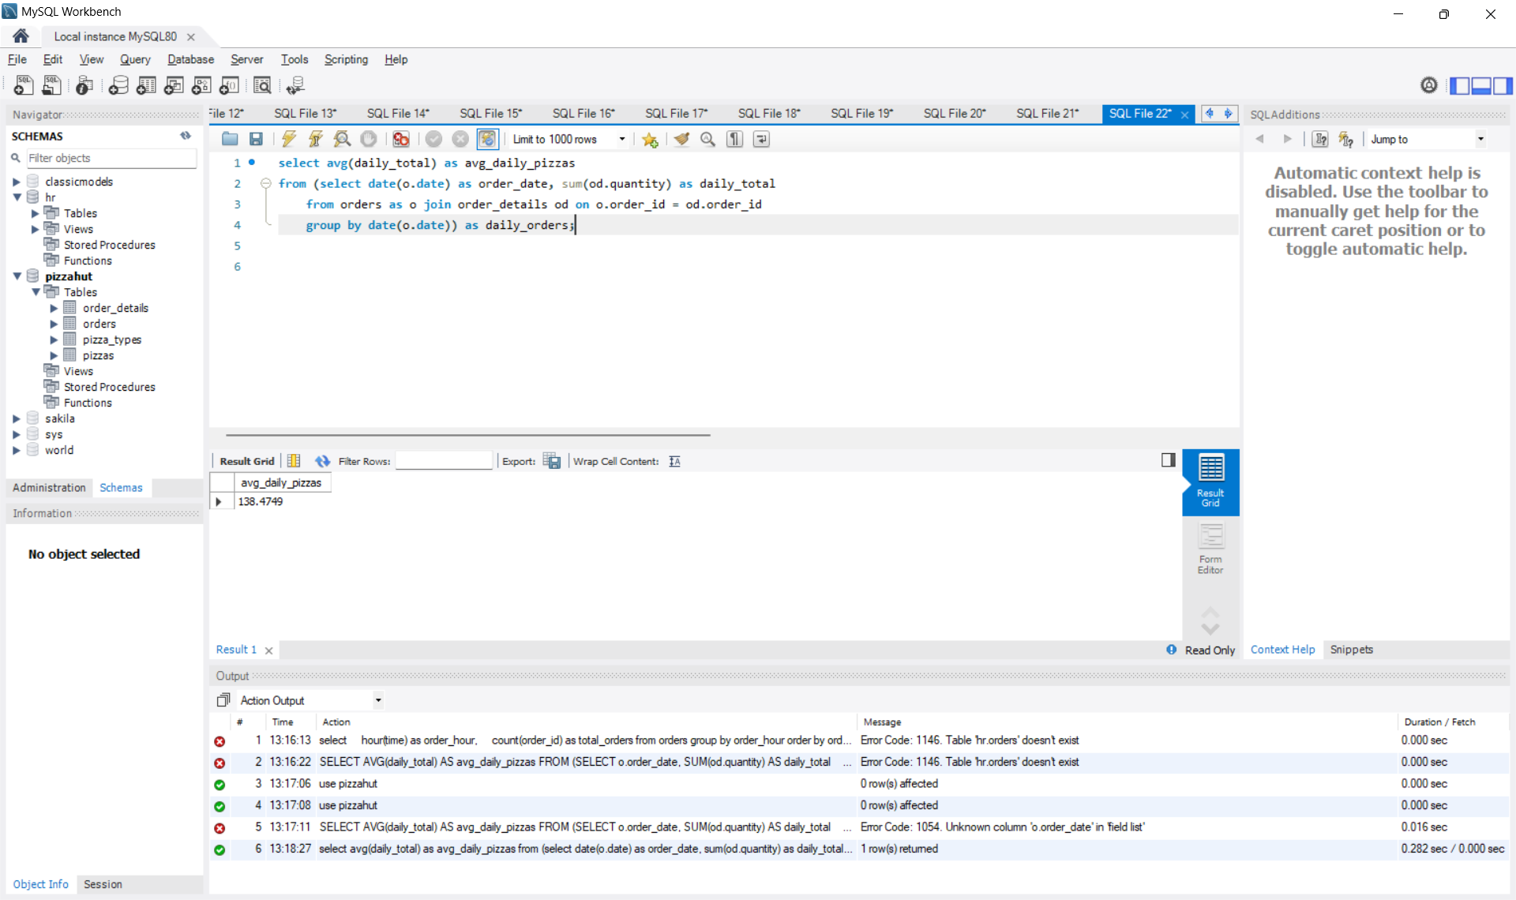
Average Daily Pizza Orders:
The average daily pizza orders at Pizza Hut is approximately 138 pizzas per day.
This metric helps in understanding daily demand and can be useful for staff planning, inventory management, and predicting future sales.

Slide 14
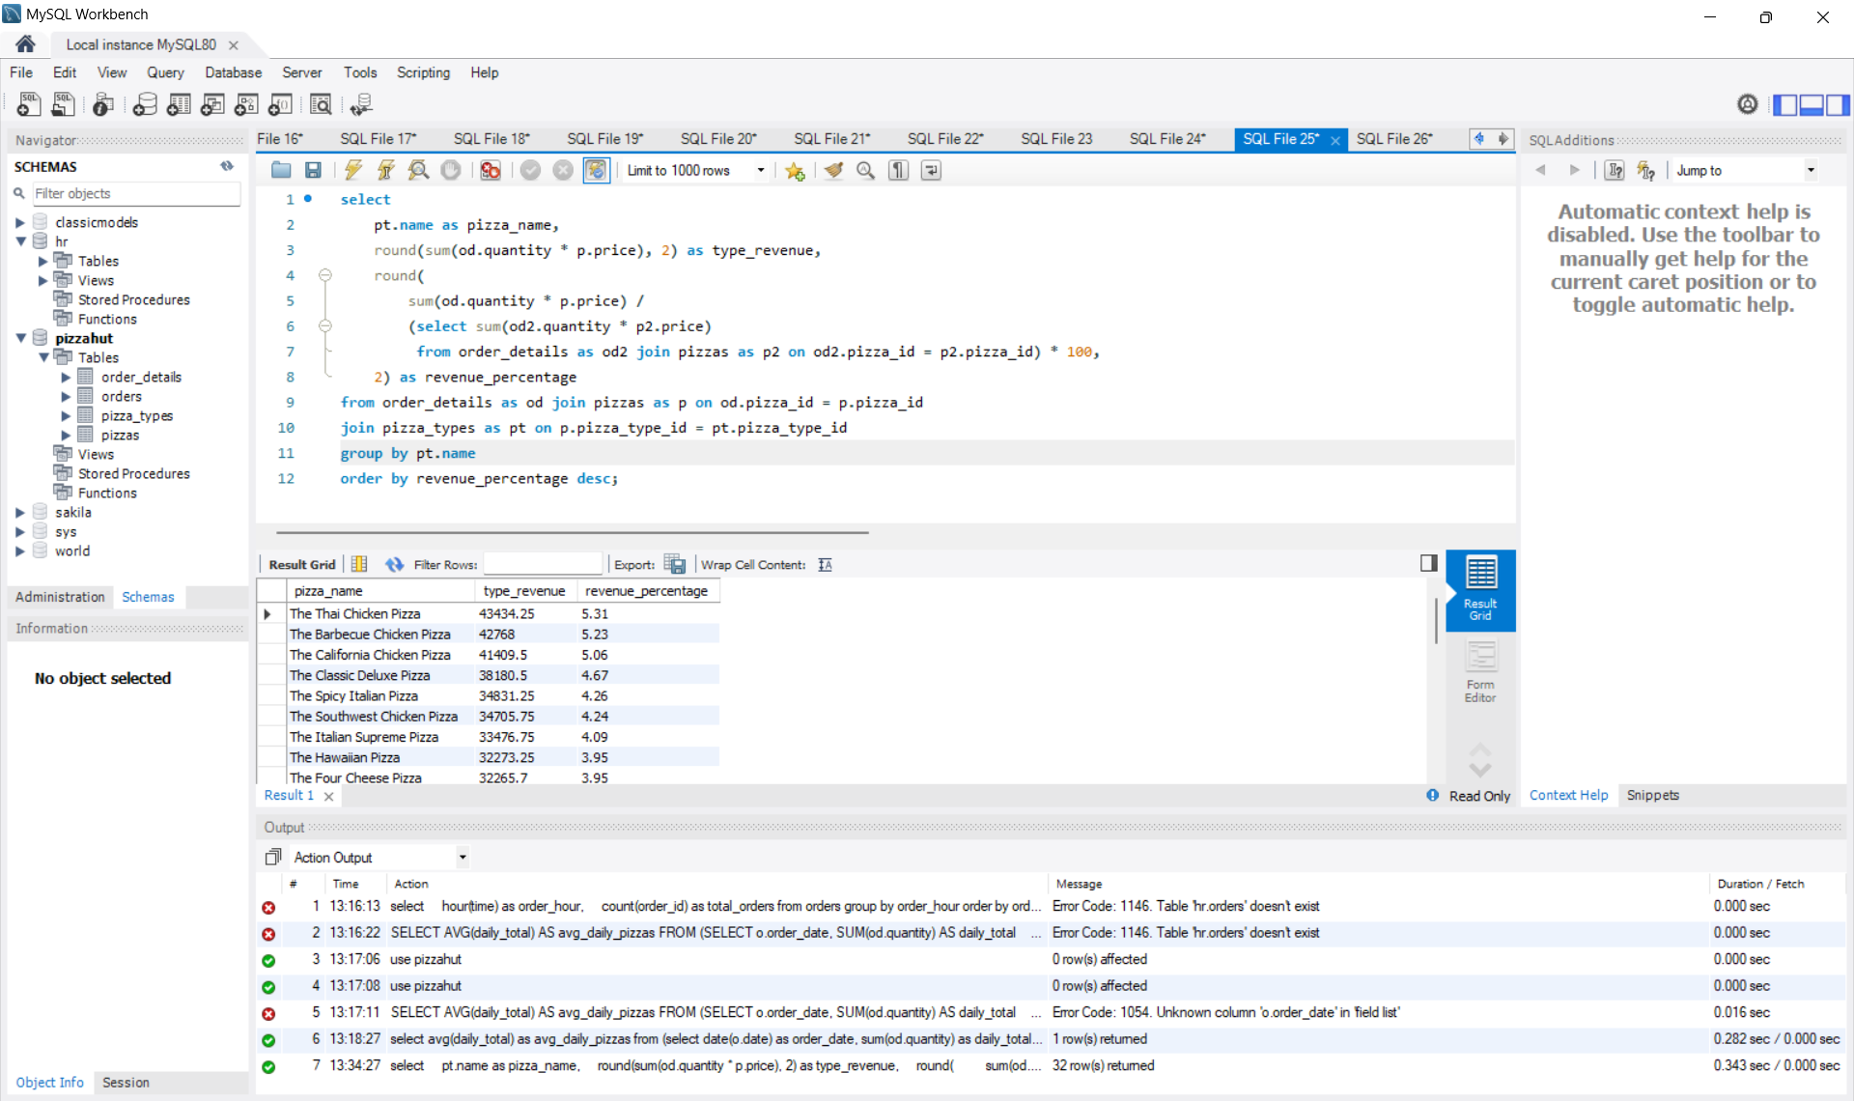
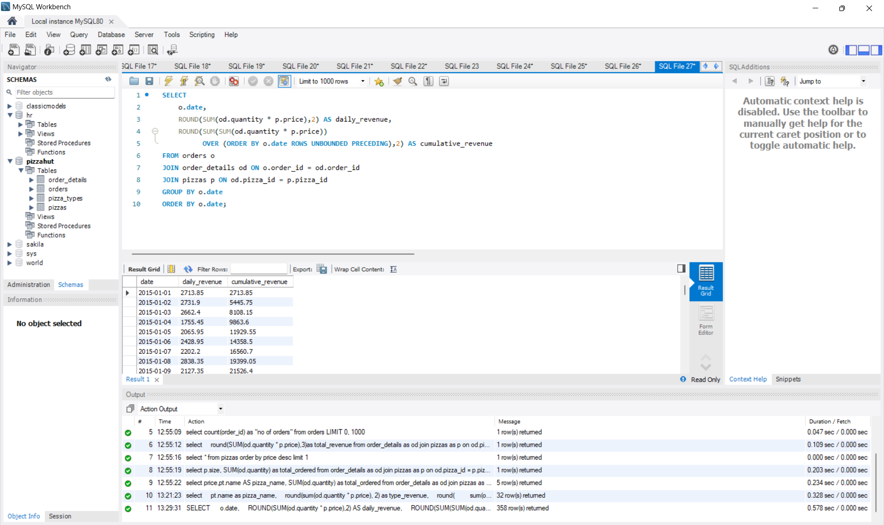
Advanced Analysis
Revenue Contribution by Pizza Type:
Cumulative Revenue Over Time:

Slide 15

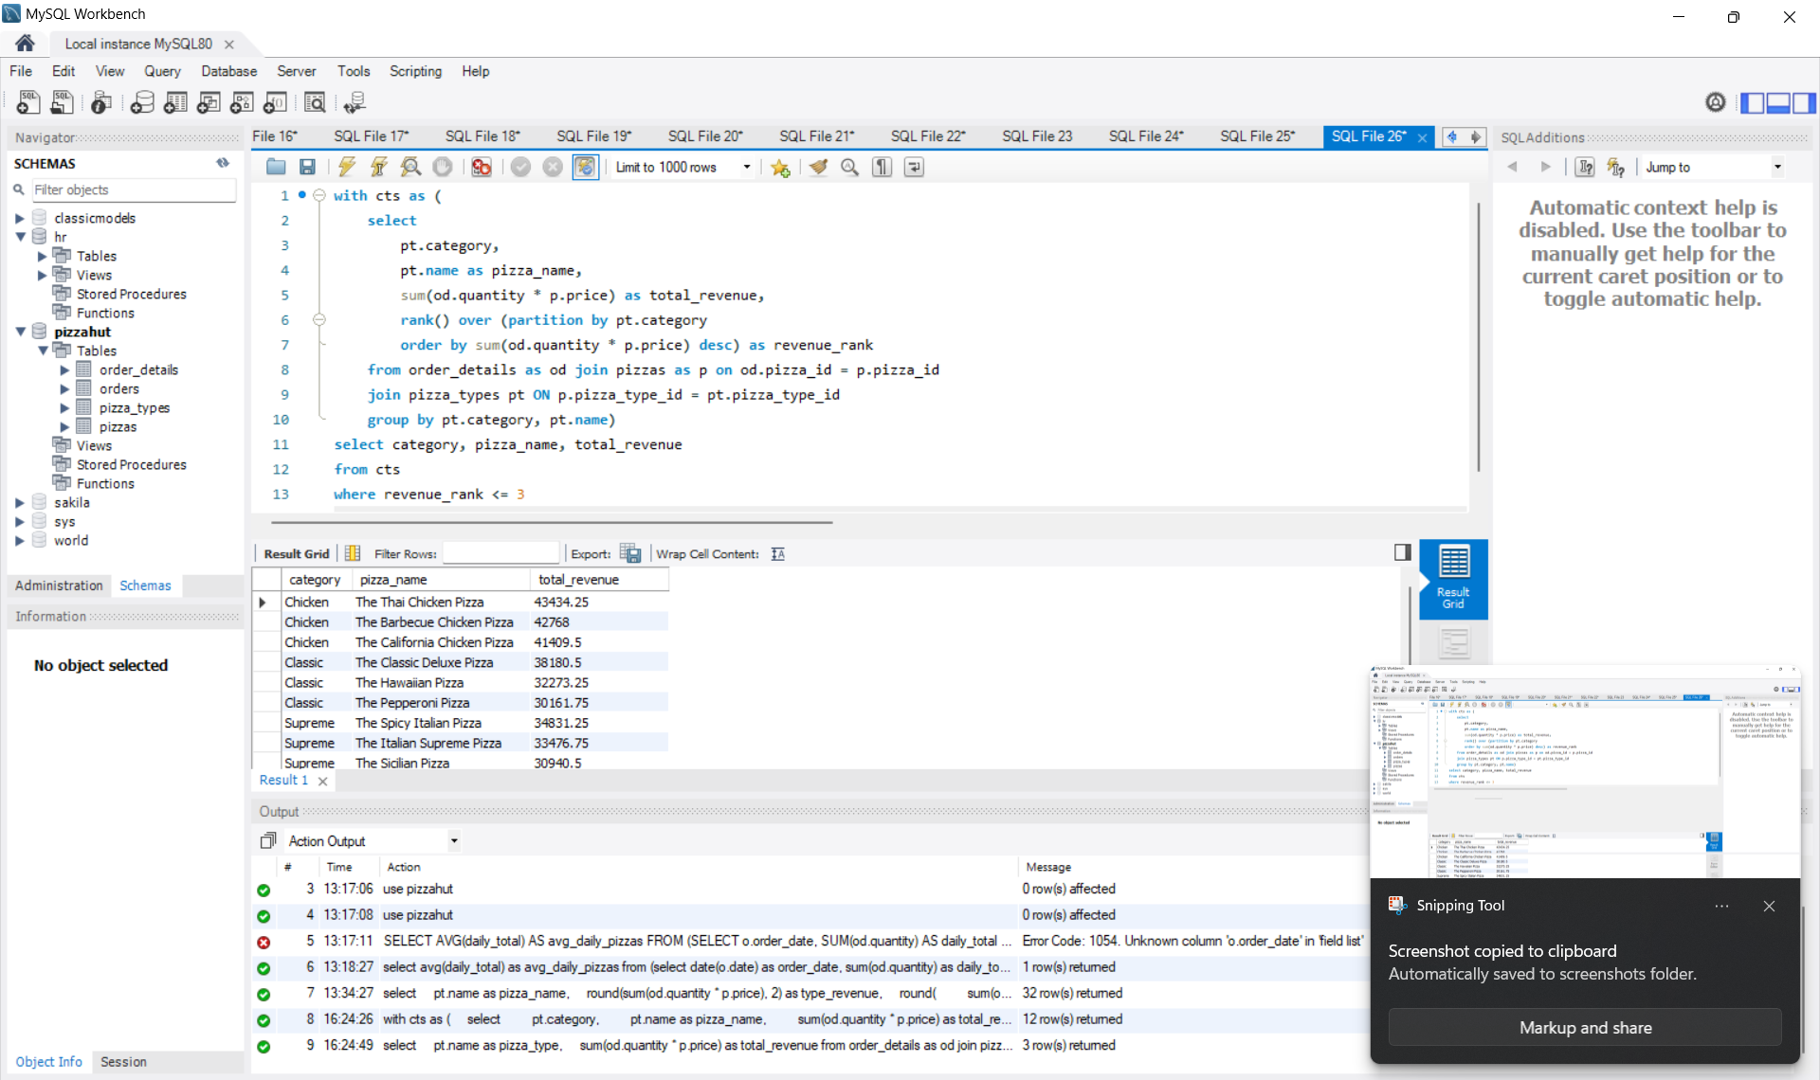
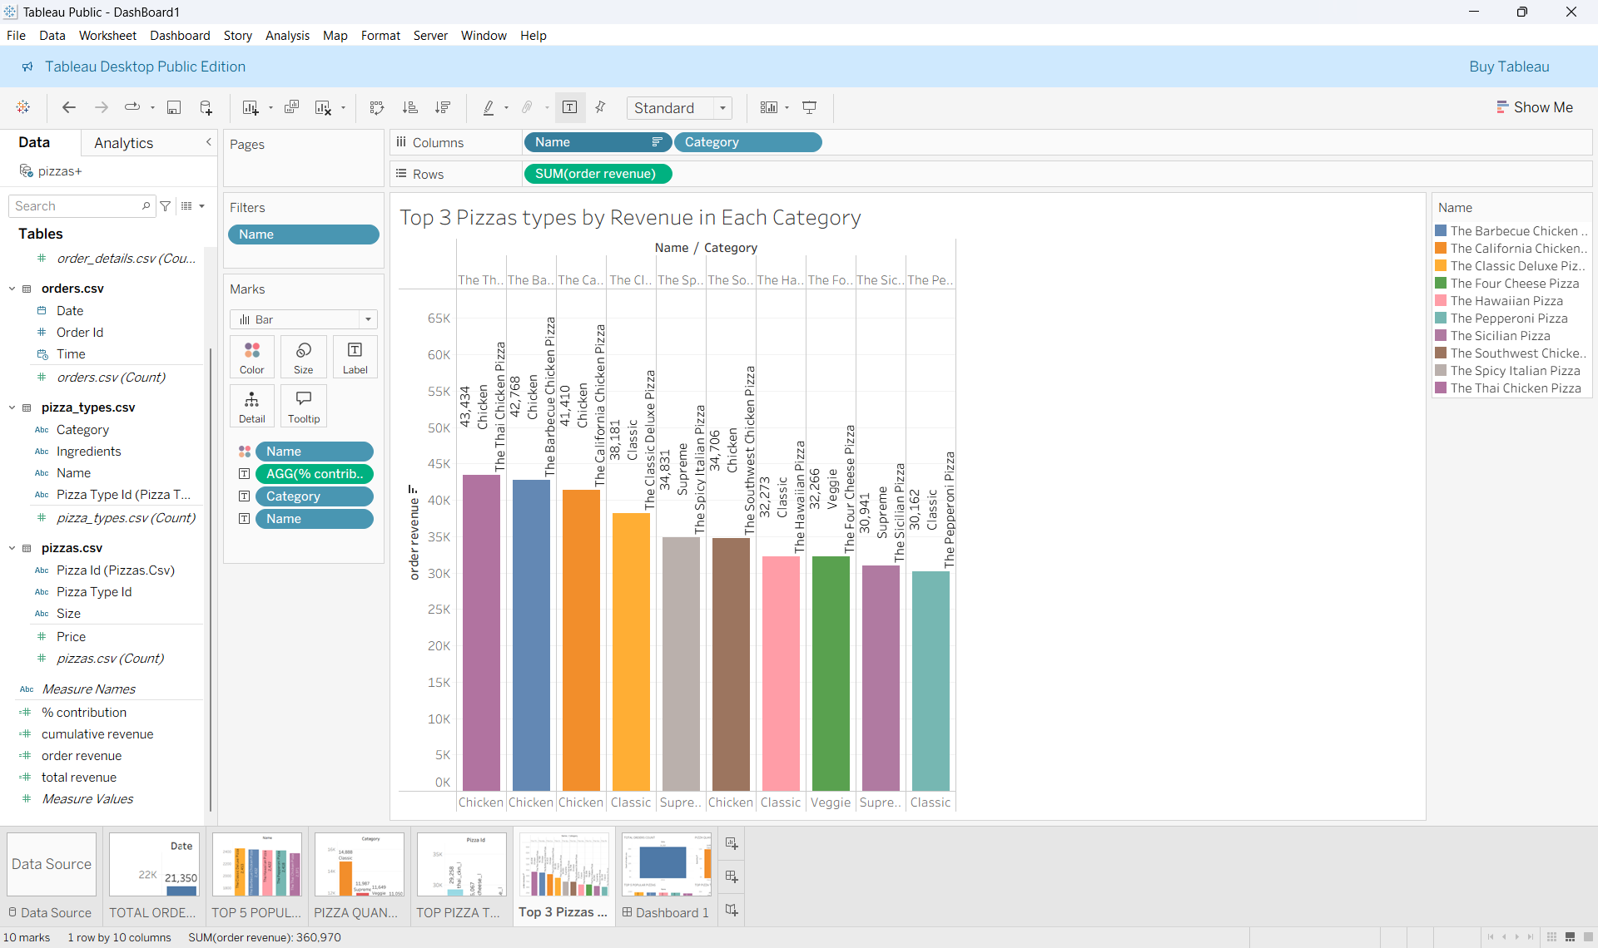
Top 3 Pizza Types By Revenue in Each Category :
Bar Graph :

Slide 16
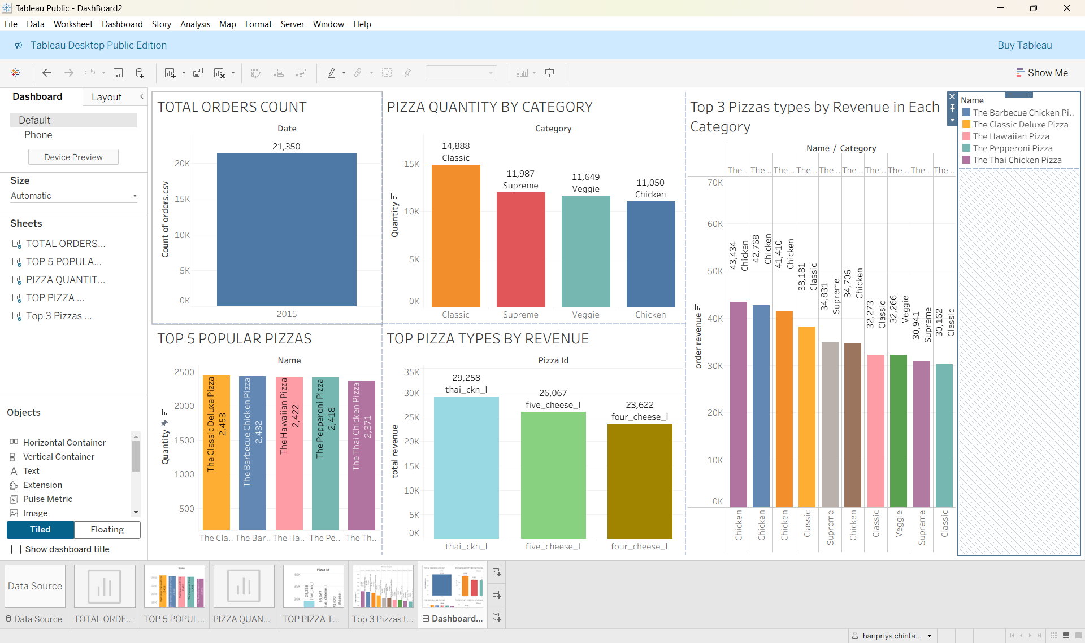
DASHBOARD

Slide 17
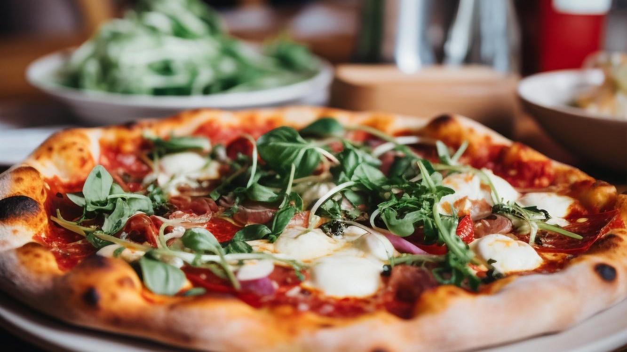


INSIGHTS
1.Customer Preferences
Most Popular Pizzas: Certain pizzas (like The classic_deluxe Pizza or Barbecue Chicken Pizza) consistently dominate in order quantity, showing strong customer demand.
Top 5 Pizzas contribute a significant share of total sales, meaning a few products drive most of the revenue.
2. Pricing & Revenue
Highest Priced Pizza identified shows what premium customers are willing to pay.
Revenue Distribution: Some pizza types/categories (e.g., Chicken or Classic) contribute more heavily to revenue than others.
3. Pizza Size Trends
Most Ordered Size: Likely Large pizzas dominate, showing families/groups prefer bigger portions.
Small pizzas may be less in demand, useful for promotions or combos.

Slide 18
RECOMMENDATIONS
1.Pricing & Promotions
Introduce combo offers (pizza + drinks + sides) to increase order value.
Give discounts on slow-moving items to reduce stock wastage.
2.Operations Improvement
Adjust staff schedules during peak hours (weekends & evenings).
Track ingredient usage to avoid shortages and minimize waste.
3.Product Strategy
Focus on top-selling pizzas for higher revenue.
Launch seasonal or limited-edition flavors to attract customers.
4.Customer Engagement
Collect customer feedback to improve taste & quality.
Use social media polls to test new flavor ideas.

Slide 19

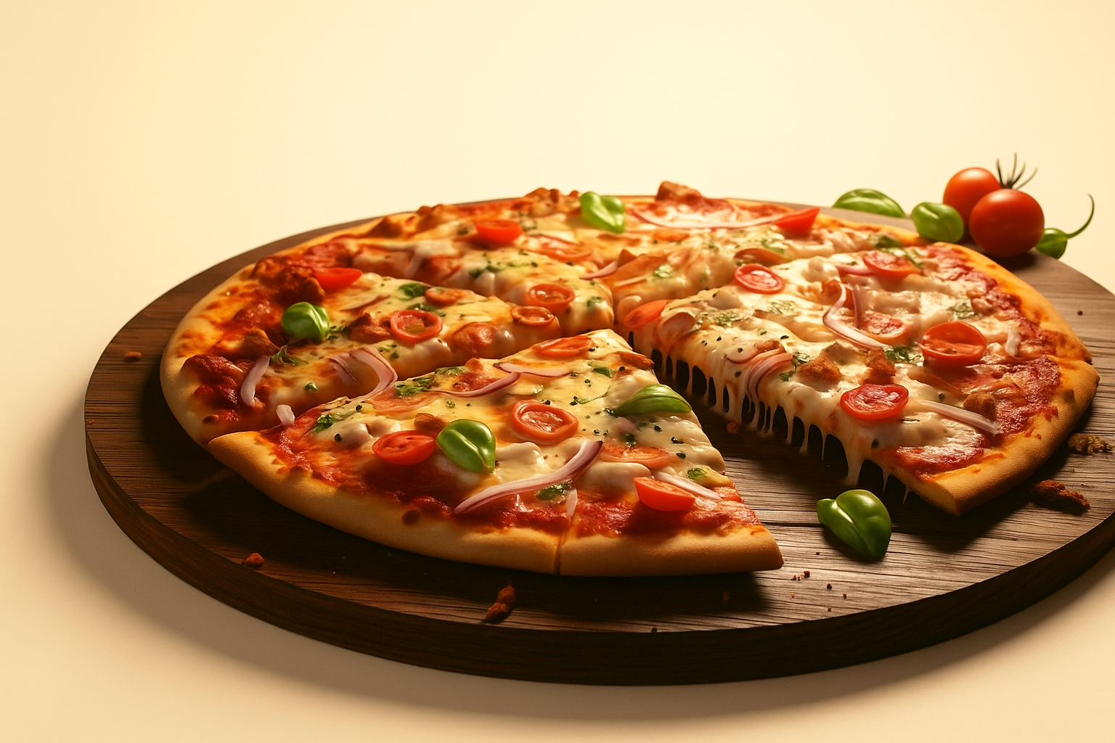

THANK YOU

